Slide 1
Evidence-Based Youth Justice By Lorraine Mazerolle National Youth Crime Symposium April 2021

Slide 2
TODAY
Thinking about what works to reduce youth offending
Where do you find existing evidence to guide practice?
Testing, Translating, Upscaling and Moving Forward

Slide 3
Terri Moffitt - Dual Taxonomy
Crime
Life course persistent
Life course persistent
Adolescent limited
Adolescent limited
birth
18-24 yrs
old age
old age
MOST YOUNG OFFENDERS AGE OUT OF CRIME; ABOUT 5% ARE ON A LIFECOURSE PATHWAY

Slide 5
What is evidence-based policing?
Evidence-based policing uses information generated from scientifically reliable evaluations of practices to inform decisions about “what works”
its about knowing and using practices and strategies that accomplish police policy missions most cost-effectively, without causing harm

Slide 6
Three Principles of Evidence Based Practice
Targeting –systematically rank and compare levels of harm associated with problematic places, people and/or situations
Testing – review existing evidence or conduct new experimental tests of methods & tactics to help chose what works best to reduce harm
Tracking – generate and use internal processes to track the daily delivery and effects of practices, including tracking the impact of the practices on crime, disorder and community perceptions of crime
Adapted from: Sherman, L. W. (2013). The rise of evidence-based policing: Targeting, testing, and tracking. Crime and justice, 42(1), 377-451.

Slide 7
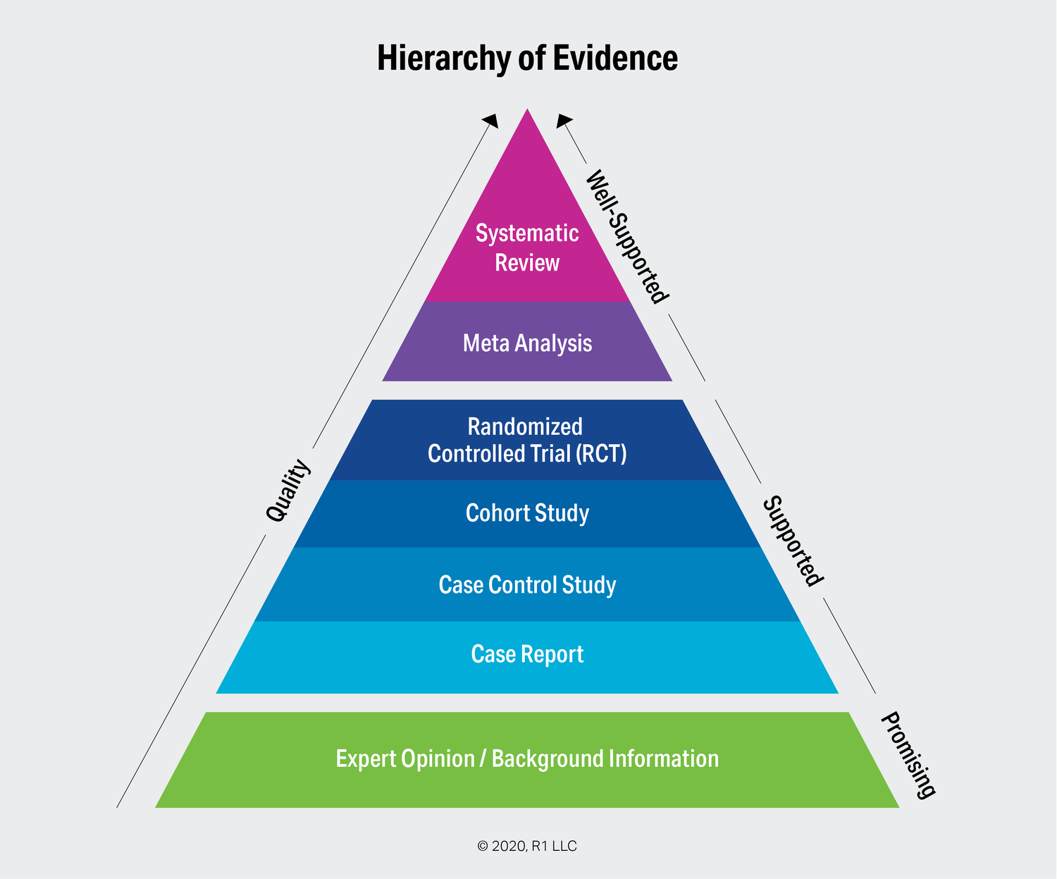
Quality of Evidence Pyramid

Slide 8
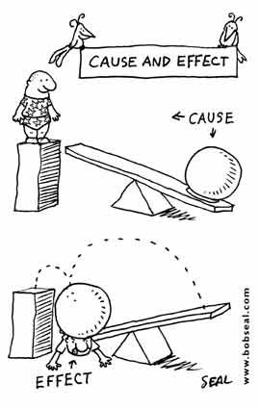

Slide 9
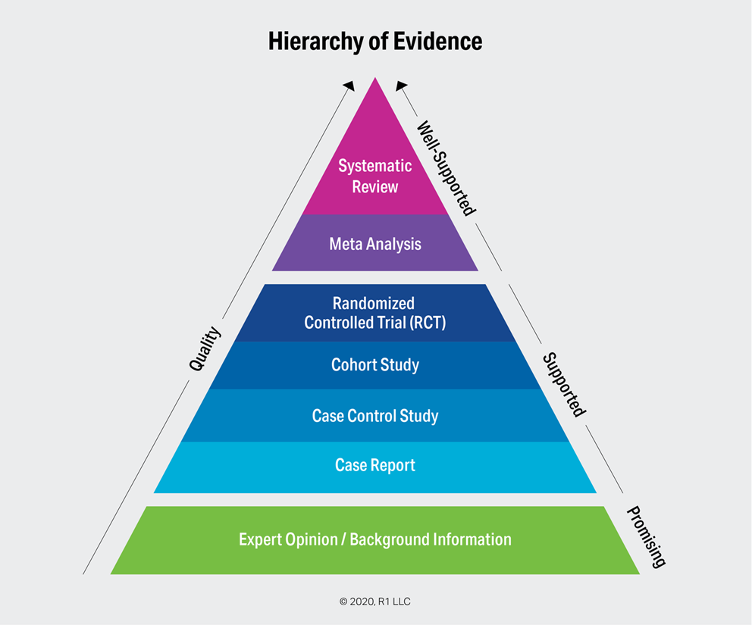
Some sobering thoughts…
The biases in estimating an intervention’s effect can be very large
Variance in estimates of effects are typically larger in weaker designs than in stronger designs
Weaker designs tend to over-estimate the treatment effects of an intervention, usually in the direction of being overly optimistic

Slide 10
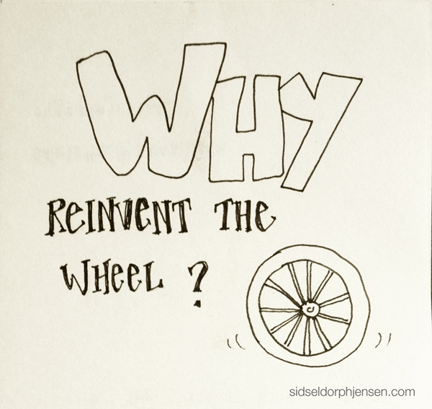

Slide 11
www.campbellcollaboration.org

Slide 13
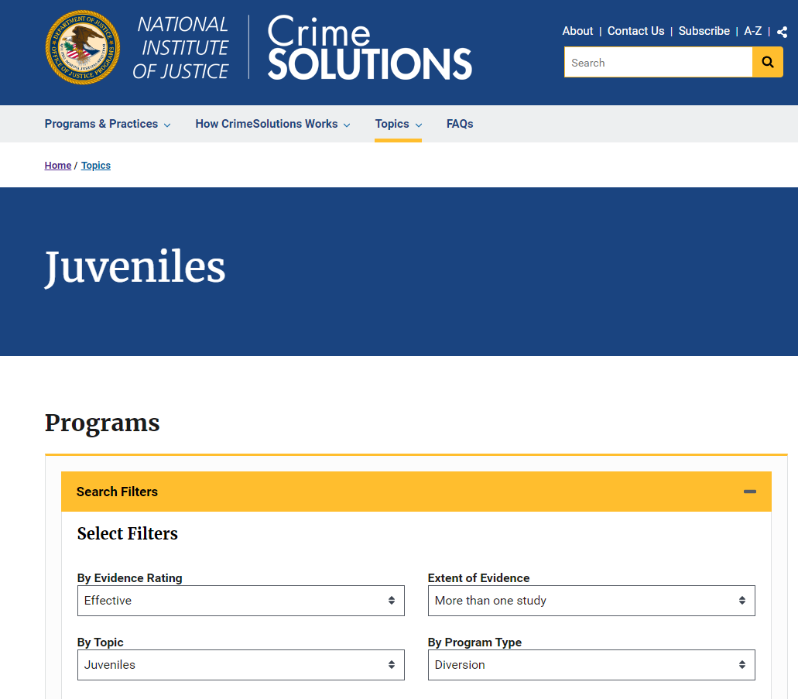
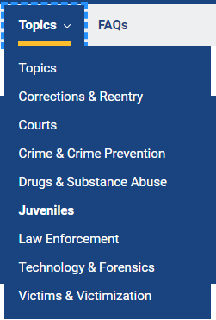
https://crimesolutions.ojp.gov/

Slide 15
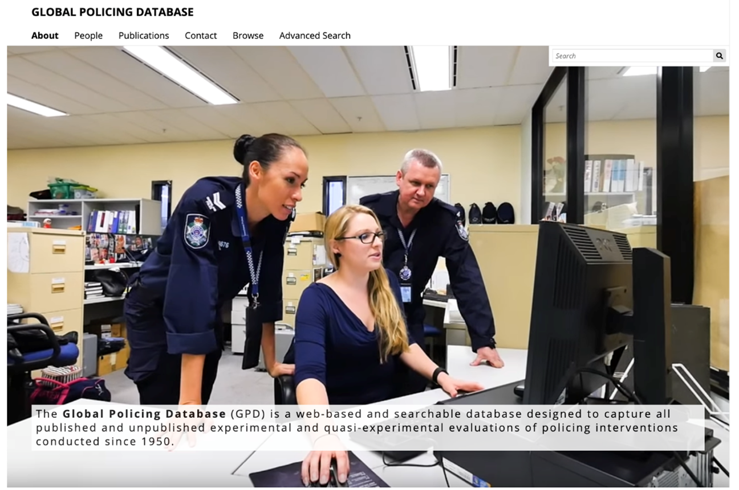
http://www.gpd.uq.edu.au

Slide 16
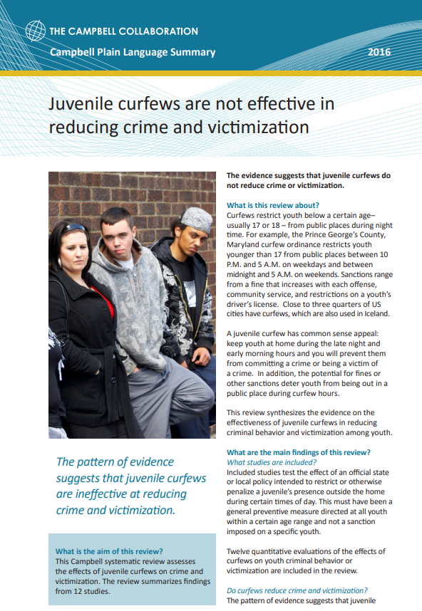

Slide 17
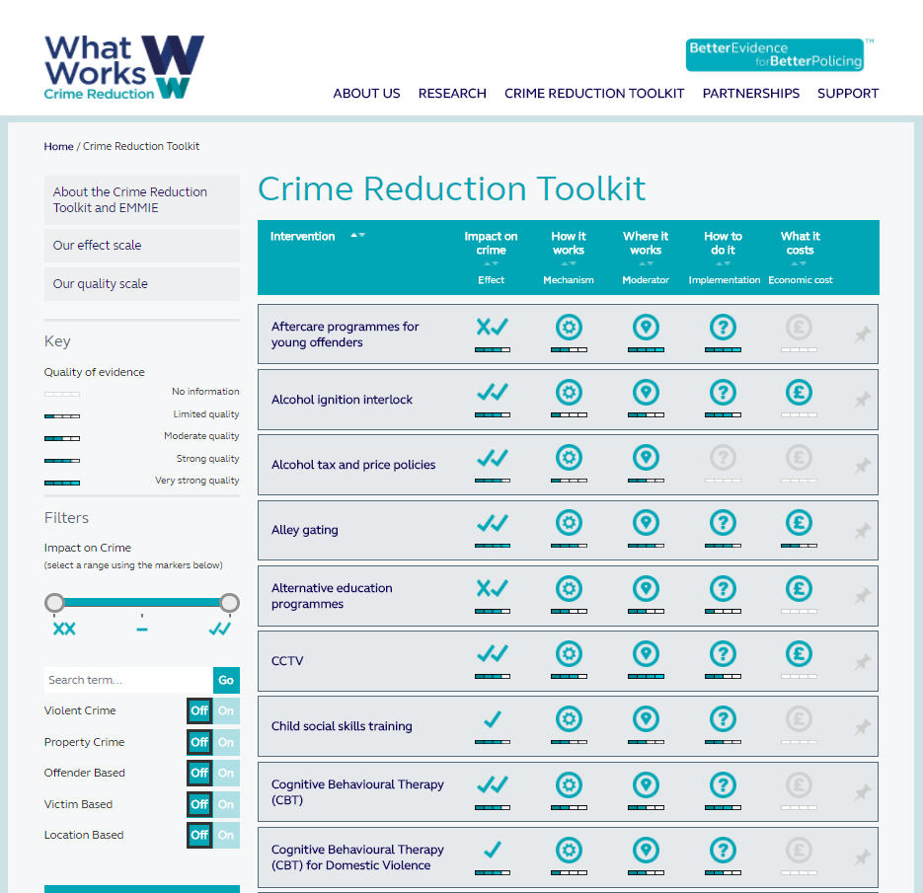
What Works for Crime Reduction
http://whatworks.college.police.uk/toolkit/Pages/Toolkit.aspx

Slide 19
Youth Endowment Fund
https://youthendowmentfund.org.uk/

Slide 20
Youth Endowment Fund – Evidence and Gap Map

Slide 21
PRISMA Flowchart

Slide 22
Number of Studies by Intervention

Slide 23
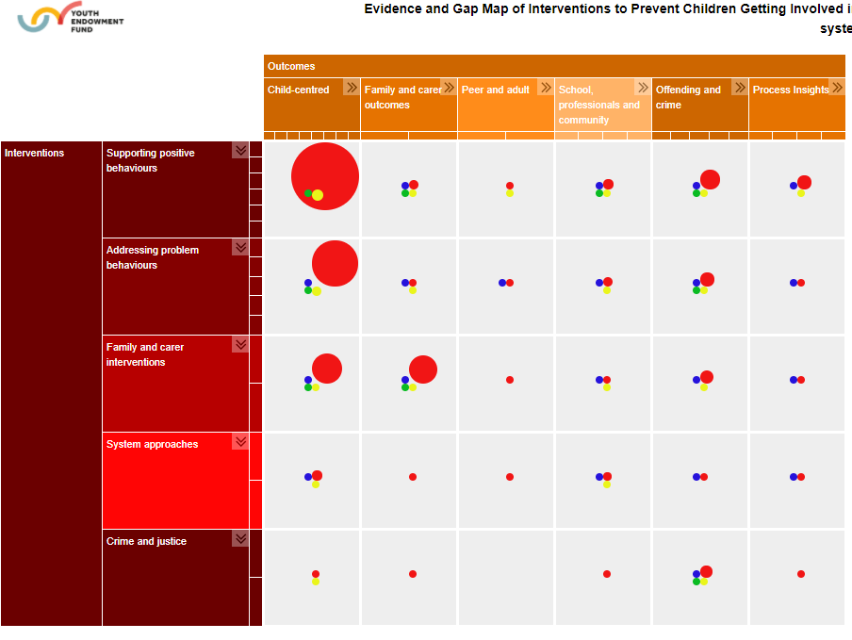
Evidence and Gap Map of Interventions to Prevent Children Getting Involved in Violence This map includes 1569 impact evaluations, 302 process evaluations and 268 systematic reviews)

Slide 24
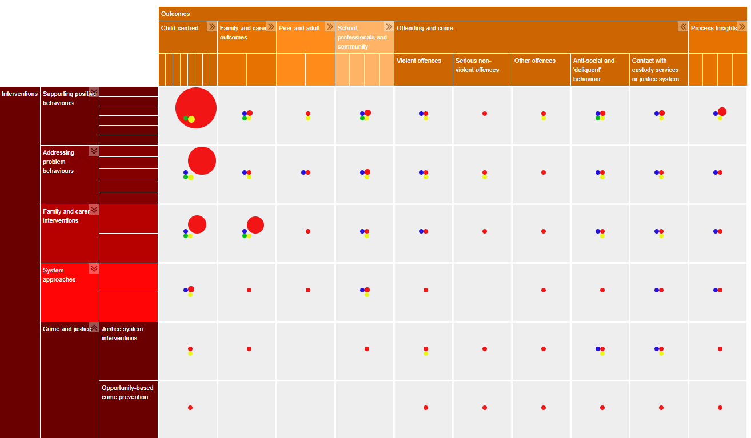
Evidence and Gap Map of Interventions to Prevent Children Getting Involved in Violence This map includes 1569 impact evaluations, 302 process evaluations and 268 systematic reviews)

Slide 25
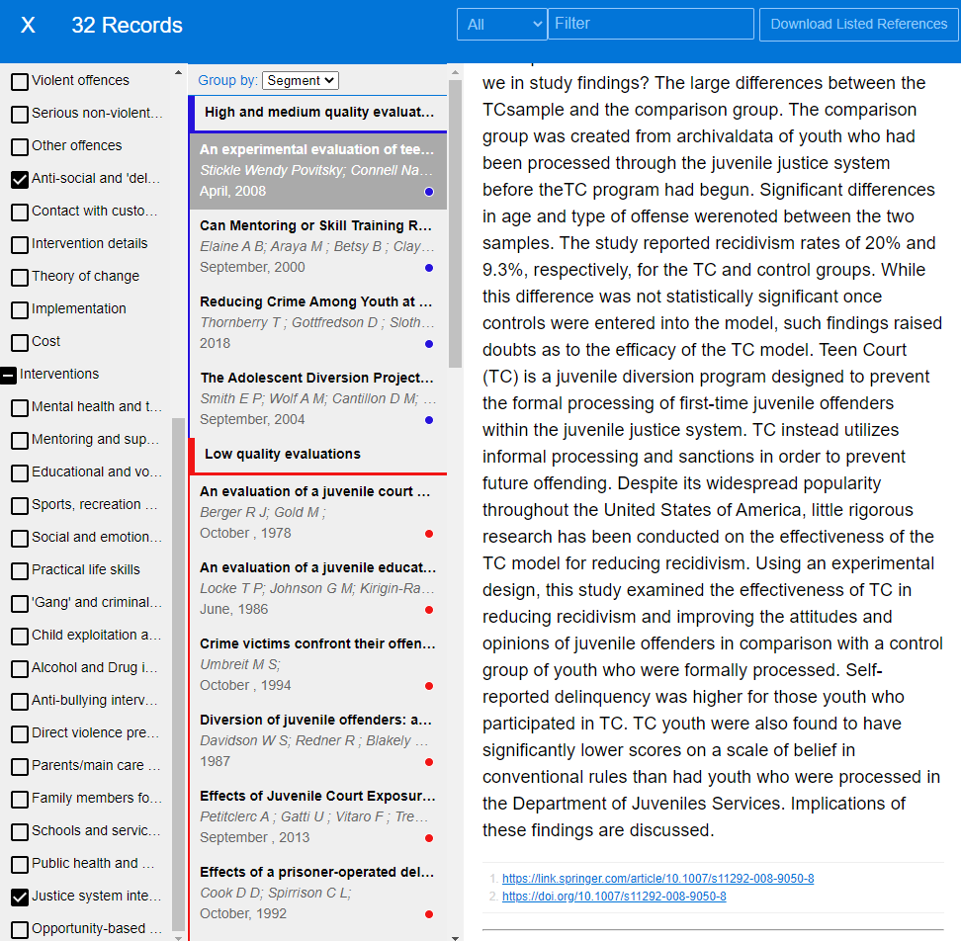
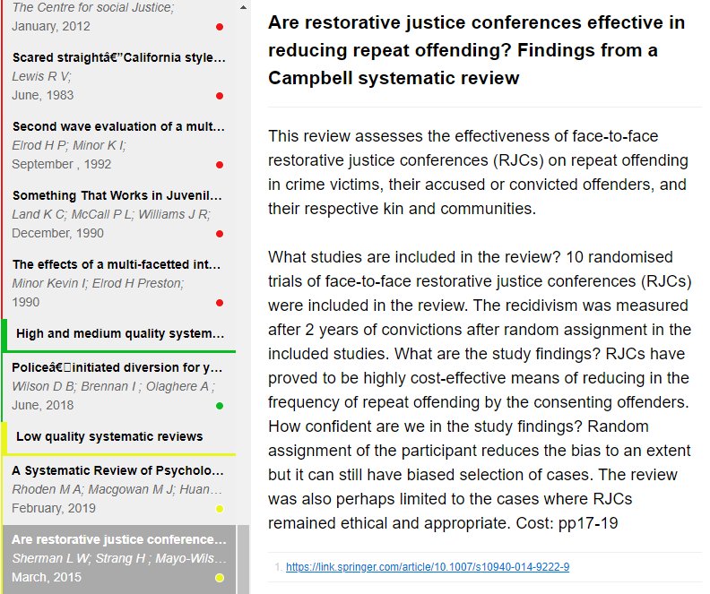
Examining the studies in the EGM

Slide 27
Truancy and Life Outcomes

Slide 28
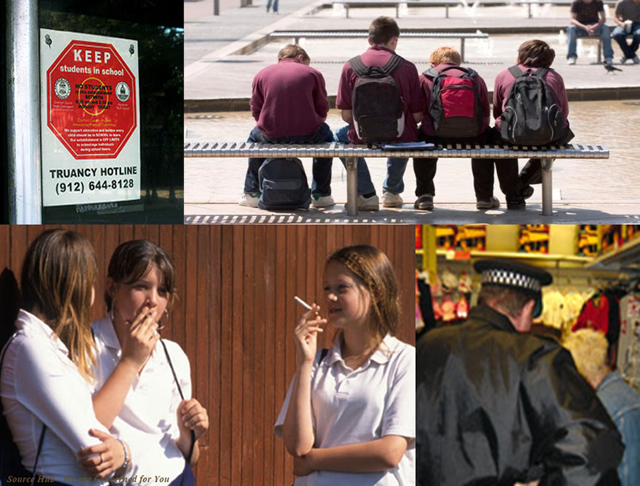
A Third Party Policing Case Study
29% of Australian students truant in any two-week period
Half a billion dollars in lost education opportunities per year
Persistent truants cost $1.5 billion (AUD) every year
98% overlap between truants and families known to police
Truants have problems in adolescence and adulthood
illicit drug use
problem alcohol use
crime
unemployment
long term life changes

Slide 29
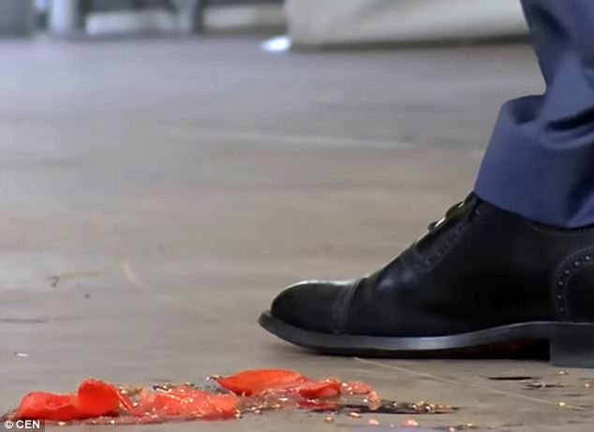
Back in 2010….

Slide 30
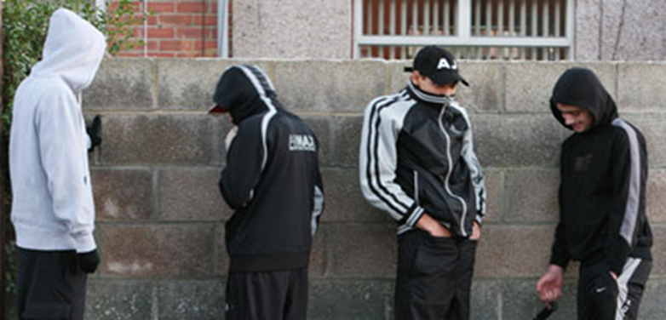
Truants were coming into frequent contact with police

Slide 31
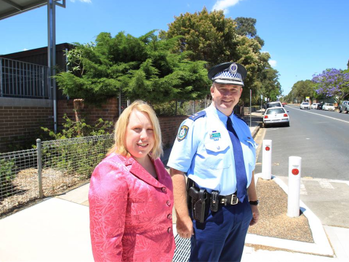
Police and schools decided to form a partnership

Slide 32
Ability School Engagement Partnership (ASEP)
Joint initiative of police, education (as the super-controller third party) with us at the University of Queensland as the experimental evaluation team
Theoretical test of Third Party Policing (TPP)
Funded by Mazerolle’s Australian Research Council (ARC) Laureate (2010 -2015)
Follow up data collection and analysis funded by the ARC Life Course Centre
11 target schools within a cluster of disadvantaged suburbs
Participants: Aged 10-16, attendance <85%, no legitimate explanation
Randomized control trial comparing Business-as-Usual to ASEP approach
102 families in trial, Recruited between 2011-2013
Short & long-term outcomes from surveys and official data

Slide 33
Third Party Policing

Slide 34
Truancy Legislation & Policy
Legislation:
Education (General Provisions) Act 2006 (Qld)
http://www.legislation.qld.gov.au/LEGISLTN/CURRENT/E/EducGenPrA06.pdf Chapter 9 Parts 1, 3, 4; Chapter 10 Parts 1- 5: Section 426
Education (General Provisions) Regulation 2006 (Qld) http://www.legislation.qld.gov.au/LEGISLTN/CURRENT/E/EducGenPrR06.pdf Part 2 Section 8, Part 4
Policy:
Department of Education and Training and Employment (2013). DETE Policy and Procedure Register. “Managing Student Absences and Enforcing Enrolment and Attendance at State Schools”. Version 3.7

Slide 35
ASEP seeks to gain willing compliance
Police/ Legal Action
Restorative Approach
Escalating legal levers
Police/ School PJ/Legitimacy
Willing Compliance
Third Party Policing

Slide 36
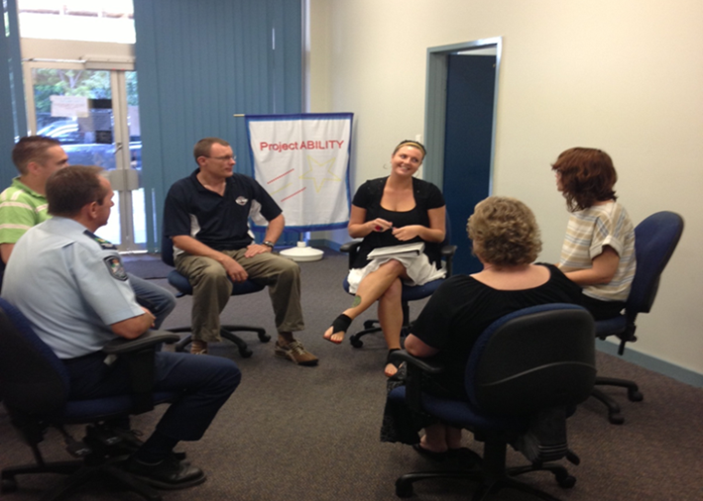

Slide 37
Business As Usual: School Principal works one-on-one with the parent of the truant

Slide 38
ASEP Trial Case Flow
Recruitment
(N = 358;
263 contacted)
Random Assignment
(N = 102)
Engagement Group (experimental)
(N = 51)
Resource Group (control)
(N = 51)
Resource Pack provided
ASEP Conference preparation
ASEP
Conference
Exit Meeting
Declined
53.3% conversion
(N = 161)
Eligibility = Aged 10-16, attendance <85%, no legitimate explanation for absences
Recruitment from Oct 2011
to May 2013 (20 months)
Average of 5 participants
recruited per month

Slide 39
Data Gathering
Baseline, 12-week, 6-month, 1-year, 2-year interview data collected from young person and guardian = 5 time points x 102 cases x 2 (YP + Adult) = 1,020 interviews
Observations + tape recording of ASEP Conference
Official police data (arrests, cautions, calls for service)
Official school data (attendance, achievement scores)
Post ASEP conference survey with all participants – schools and police

Slide 40
Parental awareness of legal obligation for child to attend school T1 to T3 (short run)
Notes:
Figure top Left:
Adults/parents in the experimental condition show a significant increase from baseline to follow up 1 in their beliefs in the likelihood that they/parents in general will be prosecuted and fined if their child does not go to school.
Figure bottom right:
Looking at how parents’ perceptions of likelihood of prosecution (at follow up 1, proximal to the conference) affects their child’s (the student) self rating of attempts to go to school more often (at follow up 2, proximal to the Exit meeting) – a moderated regression model was conducted.
In the control condition, the more likely that parents perceive prosecution to be, the less likely their child is to say they have tried to go to school more often.
(put the other way, the effect is such that only at average or +1SD levels of prosecution likelihood is there an impact of the intervention on the child trying to go to school more often (i.e., the intervention only impacted school attendance attempts when adults’ believed that prosecution for non-attendance was likely).
Prosecution Likelihood = Scale averaging reversed items :
”Parents are rarely prosecuted and fined if their child does not go to school RECODE/ “I won’t be prosecuted and fined if my child does not go back to school RECODE”
Student Try School = “Since being involved in Project ABILITY/Since the conference, I have tried to go to school more often”

Slide 41
Sustaining the gains over time (T1 to T5) Impact on self-reported antisocial behaviour over time
Notes:
Counts of self-reported antisocial behaviour (SRASB) over time between conditions. Figure 1 presents the levels of self-reported antisocial behavior at Times 1, 4, and 5 among the experimental and control groups. At Time 1, the experimental group reported a higher mean level of self-reported antisocial behavior. Results from a t test comparing the means between the conditions on self-reported antisocial behavior at Time 1 did not indicate a significant difference between the experimental and control condition (confidence interval, − .70, .28). For the experimental group, their levels of self-reported antisocial behavior were lower at Times 4 and 5, relative to the control group. However, results from t tests indicate that the mean levels of self-reported antisocial behavior were not significantly different between the two conditions at Times 4 and 5.
Overall, findings show that the experimental condition modified the effects of willingness to go to school on self-reported antisocial behavior. More specifically, willingness to go to school is only associated with reduced self-reported antisocial behavior for those in the experimental condition

Slide 42
ASEP Main Results
Reduced offending and anti-social behavior in the short (3 months), medium (1 year) and long run (2 years) post random assignment
Reduced school absences and increased a young person’s willingness to go to school in the short and medium runs
Increased parental understanding of the law, which influenced the willingness of young people to attend school
Appears that the ASEP partnership can sustain the crime control gains: reduced self-reported anti-social behavior, at one year (t4) and at two years (t5) post random assignment

Slide 43
Upscaling
New funding to implement ASEP across 3 school regions
$1.8 million from the Federal Government
Over 1,000 young people in the upscale trial
Negotiated MOU between the police and schools

Slide 44
Translating Research into Practice

Slide 45
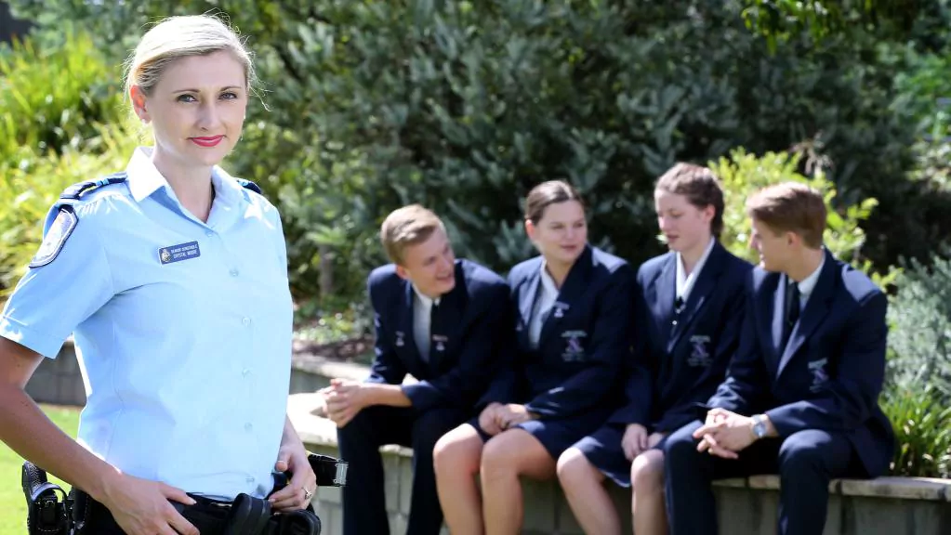
School Based Police Officers $10 million per year in Queensland

Slide 46
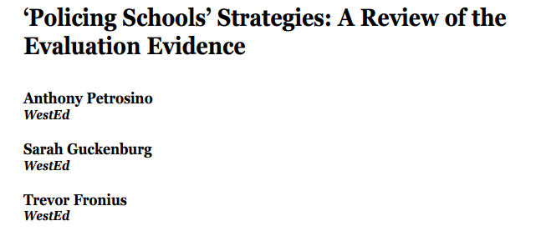
N = 11 quasi experimental evaluations
Mainly weak designs, pre-post with no comparison group
No crime control benefits found
Possible backfire effect – increase in arrests for minor student misbehaviour

Slide 50
Terri Moffitt - Dual Taxonomy
Crime
Life course persistent
Life course persistent
Adolescent limited
Adolescent limited
birth
18-24 yrs
old age
old age
MOST YOUNG OFFENDERS AGE OUT OF CRIME; ABOUT 5% ARE ON A LIFECOURSE PATHWAY

